Slide 1
TRACE
By Thomas, Michael, Vicky, and Daniel
Notes:
Thomas - explain what we do in more detail

Slide 2


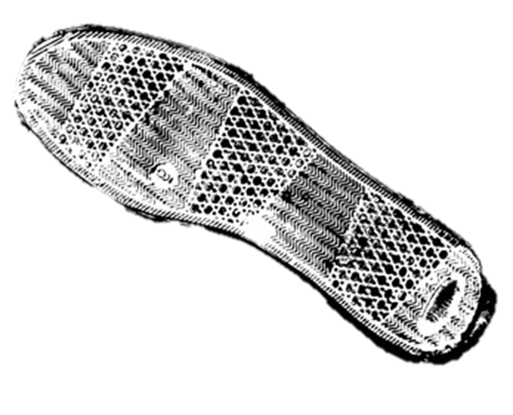

WHAT IS TRACE?
Finding what shoe the footprint belongs to through searching latest shoe purchases at stores of the same sole, identifying potential suspects.
Notes:
Thomas

Slide 3
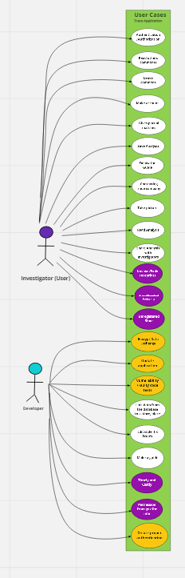
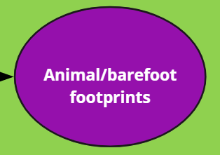
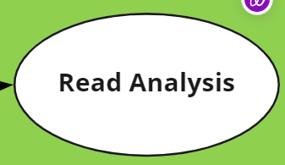
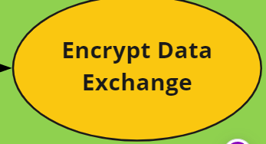
THE USE-CASE DIAGRAM
White - requirements/What we can do
Purple - - constraints (more complicated)
Orange - risk/security
Notes:
Vicky - give examples of each

Slide 4








TECH STACK & EFFORT ESTIMATION
Our Technology Plan
Effort Estimation
Platform Technology
Seven screens
Six 3GL components
Low PROD
90 Object points
No reused code
12.86 Person months
18.8 Calendar months
Web Technology
Notes:
Michael, Thomas

Slide 5




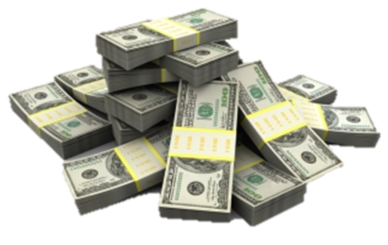
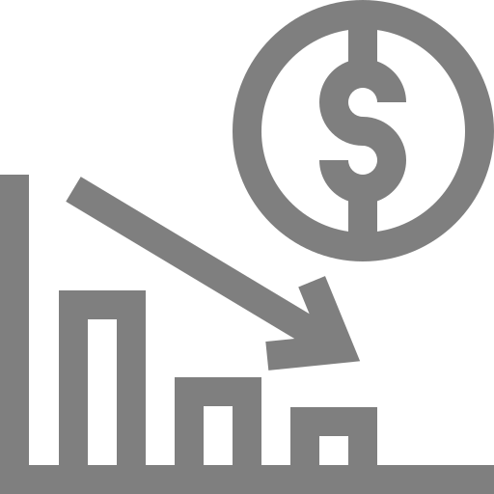

BUSINESS GOALS & RISKS
Business Goals
Business Risks
Reputation
Networking
Expanding Services
Generating Revenue
Using Less-expensive Tech
Database Breach
Financial Loss
Loss of Customers
Damage to Workspace
Decrease in Market Share
Potential Lawsuits
Privacy concerns
Notes:
Vicky

Slide 6
Technical Risks
Risks
Likelihood
Getting hacked
Poorly designed or outdated app
Incorrect data being returned
Inexperienced developers
Lack of testing
Low
Likely
Very likely
Moderate
High
Notes:
DANIEL

Slide 7
Risk Mitigation/Prevent Risk
Strategies
Studying the application (more experience of using apps)
Doing research
Putting effort into making the app secure
Doing a lot of testing
Notes:
Daniel

Slide 8
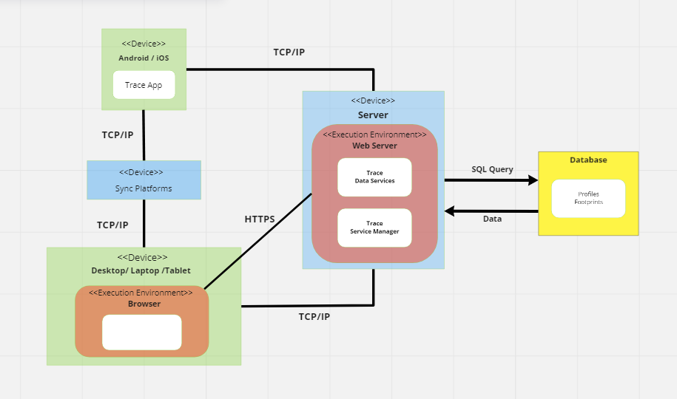
SYSTEM ARCHITECTURE
Notes:
Michael

Slide 9
THANK YOU
Do you have any questions?

